Slide 1
Final Summative: ICS4UP
By: Saahiti Annamneedi &
Alisa Nikiforova

Slide 2


Meet Cali, the advanced calculator!

Slide 3
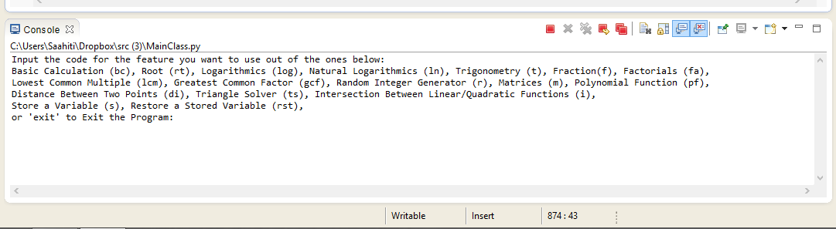
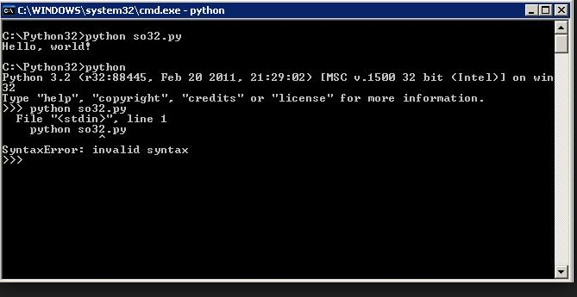
Interface
Our interface consists of a console, since PyDev Eclipse has limited GUI options:

Slide 4
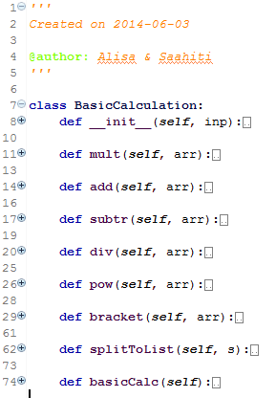
Basic Calculations
Used by tying in an equation
Can calculate basic arithmetic features, including:
‘+’, ‘-’, ‘*’, ‘/’, ‘^’ (power) and brackets
Can also restore stored values if they are integers, floats, or fractions

Slide 5
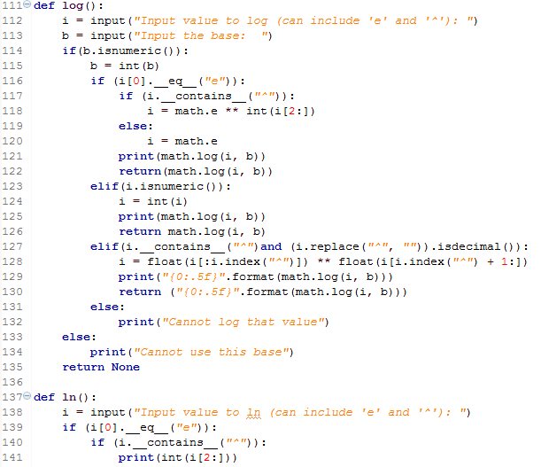
Other Basic Features
The other basic functions performed by the calculator are:
Logarithms
Natural Logarithms
Roots (all powers)
Trigonometry (in degrees)
Fractions
Factorials (up to 1000)

Slide 6
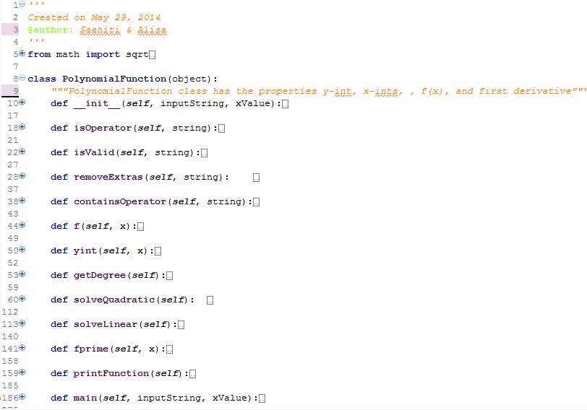
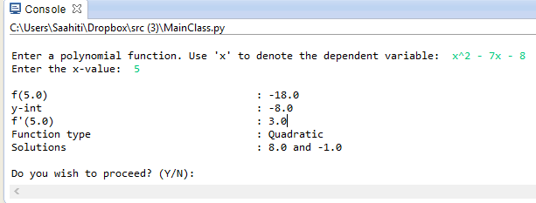
Polynomial Functions
Can determine the basic properties of a polynomial functions, such as:
The function’s value at a given x
The function’s rate of change at an instant
Y-intercept
And the solutions of linear and quadratic equations

Slide 7
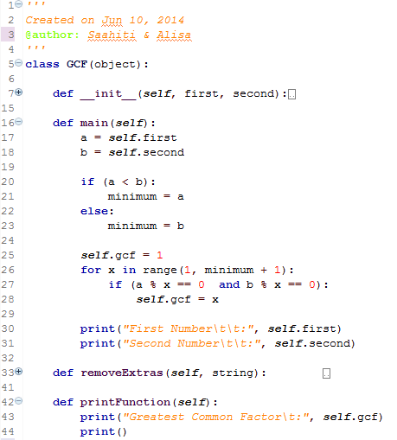
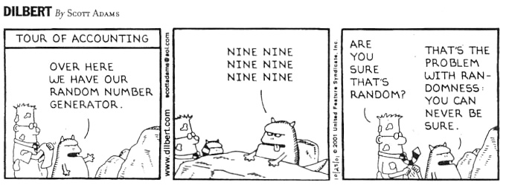
Additional Features
Greatest Common Factor
Lowest Common Multiple
Random Number Generator (with range options)

Slide 8
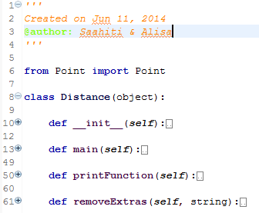
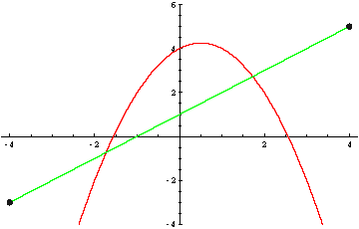
Other Graph Features
Distance Between Two Points
Intersection Between Linear/Quadratic Functions
Finds the intersection(s) between:
Two lines
A line and a Quadratic
Two Quadratics

Slide 9
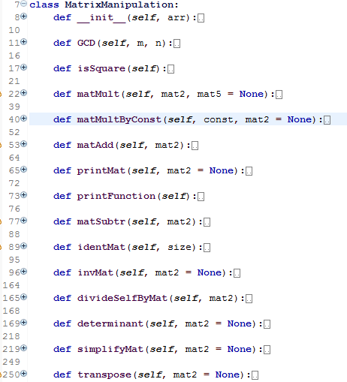
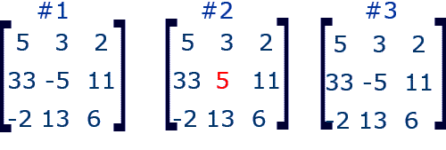
Matrices
This feature includes:
Matrix addition
Matrix subtraction
Matrix Multiplication
Matrix Division
Finding the determinant of any sized square matrix
Finding the inverse of any sized square matrix
Simplifying Matrices
Transposing Matrices

Slide 10
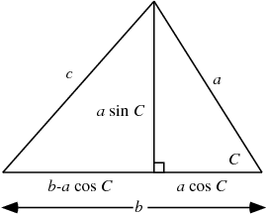
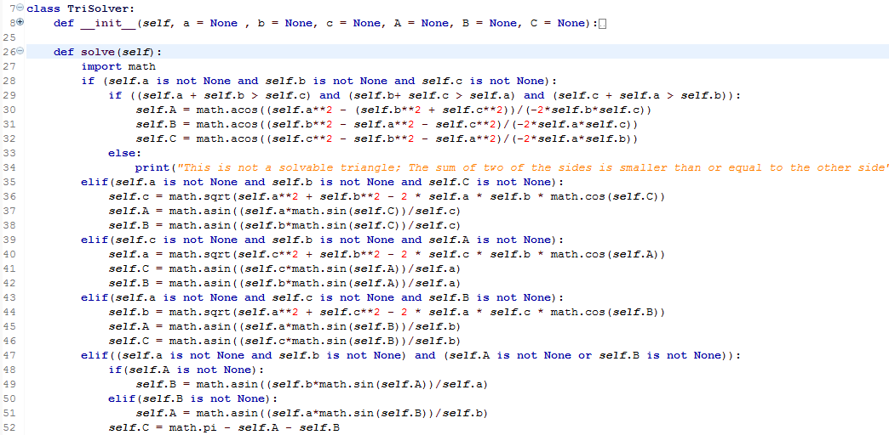
Triangle Solver
Solves triangles if:
All sides are given
Two sides and an angle are given
Two angles and a side are given

Slide 11
Thank you!

